Slide 1


Slide 2


VISVESVARAYA TECHNOLOGICAL UNIVERSITY
JNANA SANGAMA, BELAGAVI– 590018, KARNATAKA, INDIA
A PROJECT
on
“MEDICAL MANAGEMENT SYSTEM”
Submitted in partial fulfillment of the requirements for the award of
BACHELOR OF ENGINEERING
in
ARTIFICIAL INTELLIGENCE AND MACHINE LEARNING
Submitted By
Name USN
SHREESHA B 4VP20AI027
SNEHA B 4VP20AI030
DEPARTMENT OF ARTIFICIAL INTELLIGENCE & MACHINE LEARNING
VIVEKANANDA COLLEGE OF ENGINEERING & TECHNOLOGY
[A Unit of Vivekananda Vidyavardhaka Sangha Puttur (R)]
Affiliated to Visvesvaraya Technological University and Approved by AICTE New Delhi & Govt., of Karnataka
Nehru Nagar, Puttur - 574 203, DK, Karnataka, India.
January, 2023

Slide 3
Problem Statement
The current medical management system in place is often manual and disorganized, leading to inefficiencies in data management and decision-making. Key issues faced include:
Lack of centralization: Data is often stored in disparate locations, making it difficult to access and use effectively.
Inaccurate and outdated information: Manual data entry and lack of regular updates result in inaccurate and outdated information being used in decision-making.
Inefficient inventory management: The current system lacks an automated system for tracking inventory levels, leading to stock shortages and overstocking.
Time-consuming data entry: The manual data entry process is time-consuming and prone to errors, leading to decreased efficiency and increased costs.
It was determined that a new medical management system was needed to improve the efficiency and accuracy of the medical management activities.
The new system would provide a centralized database for storing and accessing data, as well as an automated system for tracking inventory levels and managing appointments. Additionally, the system would be designed to be user-friendly and intuitive, making it easy for medical staff to access and manipulate the data. The overall goal of this project is to provide a comprehensive and effective system for managing the day-to-day activities of a medical management organization.

Slide 4
INTRODUCTION
The Medical Management System is a comprehensive software solution designed to automate the operations of a medical store.
The system aims to centralize and manage customer, employee, medicine, supplier, purchase, and sales data, thereby increasing the efficiency and accuracy of the medical store's activities.
The system includes features such as triggers, views, and stored procedures, which enhance the security and efficiency of the database.
The system also has a user-friendly graphical interface and role-based access control to ensure that only authorized staff can access sensitive information.
The goal of the project is to provide a robust and reliable solution for managing a medical store, ultimately leading to improved patient safety and increased business outcomes.
Objectives of the project :
Develop and implement a comprehensive database management system for a medical management organization
Centralize data storage and provide a user-friendly interface for accessing and modifying data
Improve efficiency and accuracy of the activities
Enhance inventory management and tracking
Store and manage customer’s and staff information's
Offer user-friendly and secure interface
Improve patient safety and increase business outcomes.

Slide 5
Implementation of Table Creation and Insertion
Eg: SUPPLIERS TABLE
CREATE TABLE syntax:
create table SUPPLIERS
(
Sup_ID varchar (6),
Sup_Name varchar (30) not NULL,
Sup_Mail varchar (40) not NULL,
Sup_Phone decimal (10,0) not NULL,
Sup_Add varchar (30) not NULL,
primary key (Sup_ID)
);
CREATE TABLE [table name] (
[column name] [data type] [constraints],
[column name] [data type] [constraints],
...
);
Insert data into table syntax:
INSERT INTO [table name] ([columns])
VALUES ([values]);
Eg: Insert data into SUPPLIERS Table:
insert into SUPPLIERS (Sup_ID, Sup_Name, Sup_Mail, Sup_Phone, Sup_Add) values ('SU5', 'GHC Limited', 'ghc@gmail.com', '9876543214', '654 Main St');

Slide 6
Implementation of Triggers Triggers are stored programs, which are automatically executed or fired when some events occur.
Triggers Syntax:
Eg: net_total_amt
CREATE TRIGGER neg_total_amt
BEFORE INSERT ON SALES
FOR EACH ROW
BEGIN
IF NEW.Total_Amt < 0 THEN
SIGNAL SQLSTATE '45000'
SET MESSAGE_TEXT = 'Total amount cannot be negative';
END IF;
END;
CREATE TRIGGER [trigger_name]
[AFTER/BEFORE] {INSERT/UPDATE/DELETE}
ON [table_name]
[FOR EACH ROW]
BEGIN
[trigger body]
END;
net_total_amt trigger is to prevent negative values from being inserted into the Total_Amt column. This trigger is activated before any insert operation on the SALES table and checks if the value of Total_Amt is less than zero. If so, the trigger raises an error and the insert operation is rolled back.

Slide 7
Eg: update_age_on_insert
Eg: check_purchase_quantity_cost_insert
CREATE TRIGGER update_age_on_insert
BEFORE INSERT ON EMPLOYEE
FOR EACH ROW
BEGIN
SET NEW.age = EXTRACT(YEAR FROM CURDATE()) - EXTRACT(YEAR FROM NEW.E_Bdate) -(DATE_FORMAT(CURDATE(), '%m%d') < DATE_FORMAT(NEW.E_Bdate, '%m%d'));
END;
CREATE TRIGGER check_purchase_quantity_cost_insert
BEFORE INSERT ON PURCHASE
FOR EACH ROW
BEGIN
IF (NEW.P_Qty < 0 OR NEW.P_Cost < 0) THEN
SIGNAL SQLSTATE '45000'
SET MESSAGE_TEXT = 'Error: Purchase quantity and cost cannot be negative.';
END IF;
END;
A trigger named "update_age_on_insert" was created on the EMPLOYEE table.This trigger is activated before any insert operation on the EMPLOYEE table and calculate the age of the employee by comparing the current date with the birthdate of the employee.
This trigger is "check_purchase_quantity_cost_insert" which is a before insert trigger for the table "PURCHASE", it checks for any negative values for the columns P_Qty and P_Cost and throws an error message if any is found.

Slide 8
Implementation of Views A view is a virtual table based on the result-set of an SQL statement.
Views Syntax:
Eg: INVOICES View
CREATE VIEW view_name AS
SELECT column1, column2, ...
FROM table_name
WHERE condition;
CREATE VIEW INVOICES AS
SELECT s.S_ID AS S_ID, c.C_Fname AS C_Fname, c.C_Lname AS C_Lname, s.S_Date AS S_Date, s.Total_Amt AS Total_Amt
FROM SALES s
JOIN CUSTOMER c ON s.C_ID = c.C_ID;
A view named "INVOICES" was created to provide a simplified view of data from the SALES and CUSTOMER tables.
This view includes the sales ID, customer first name, customer last name, sale date, and total amount from the SALES table, and
joins it with the corresponding customer data from the CUSTOMER table.

Slide 9
Implementation of Stored Procedures A stored procedure is a pre-compiled database object that contains a set of SQL statements that can be executed.
Eg: Add customer
Syntax of Stored Procedure
CREATE PROCEDURE add_customer (
IN p_cid VARCHAR(6),
IN p_cfname VARCHAR(30),
IN p_clname VARCHAR(30),
IN p_caddress VARCHAR(30),
IN p_cage INT(11),
IN p_csex VARCHAR(6),
IN p_cphone DECIMAL(10,0),
IN p_cmail VARCHAR(40)
)
BEGIN
INSERT INTO CUSTOMER (C_ID, C_Fname, C_Lname, C_Address, C_Age, C_Sex, C_Phone, C_Mail) VALUES (p_cid, p_cfname, p_clname, p_caddress, p_cage, p_csex, p_cphone, p_cmail);
END;
CREATE PROCEDURE procedure_name (IN parameter1 data_type, IN parameter2 data_type, ...)
BEGIN
-- Procedure body (SQL statements)
END;
Calling of Stored procedure
CALL add_customer('$C_ID', '$C_Fname', '$C_Lname', '$C_Address', '$C_Age', '$C_Sex', '$C_Phone', '$C_Mail');

Slide 10
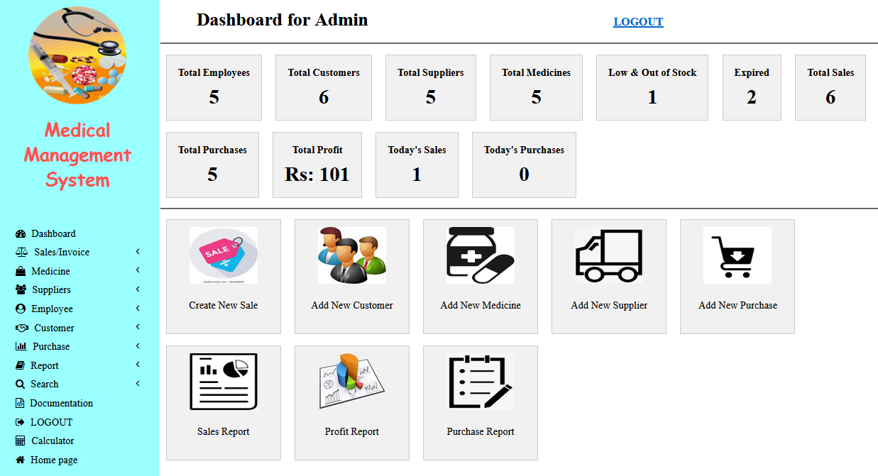
Snapshots
Administrator dashboard
The page is likely a web-based interface that allows the administrator to manage various aspects of the medical shop, such as inventory, sales, and customer information.
The layout of the page is likely divided into several sections, each with its own specific function. There may also be a menu bar on the left side of the page that allows the administrator to access specific features such as adding new products, managing customer information, and viewing sales reports.
The main section of the page is likely devoted to displaying information relevant to the administrator's current task. This may include a list of products in the inventory, customer information, or sales data. The administrator may also be able to perform actions such as adding new products, editing customer information, and generating reports from this section of the page.

Slide 11
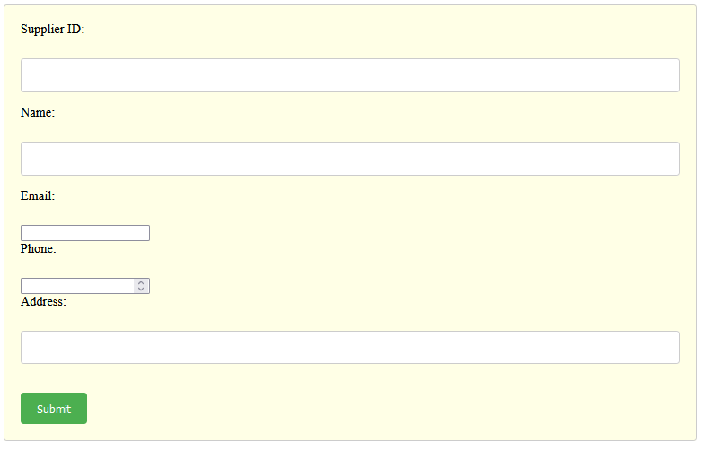
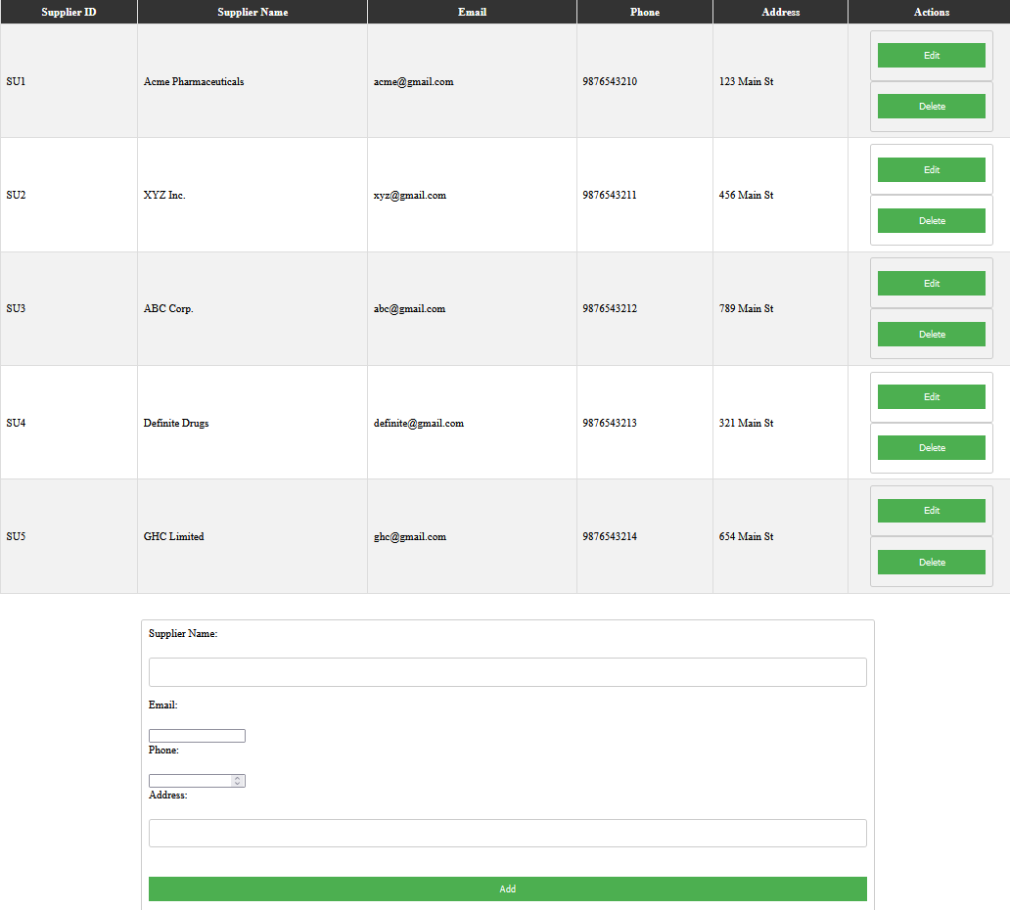
Add Suppliers
Manage Suppliers

Slide 12
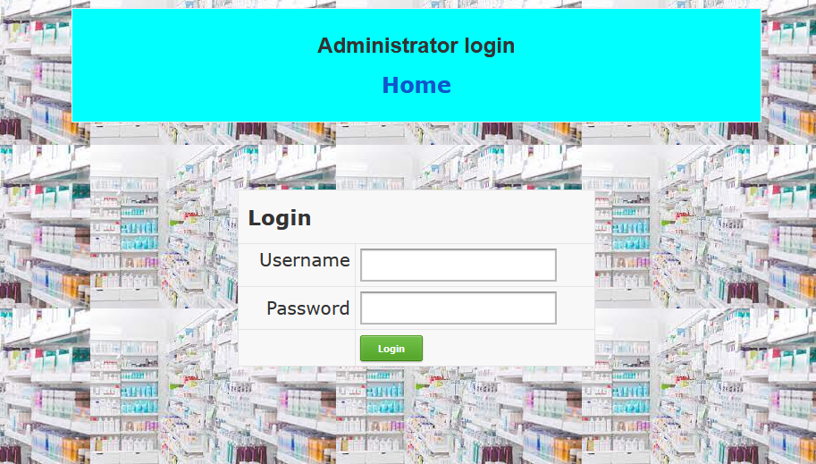
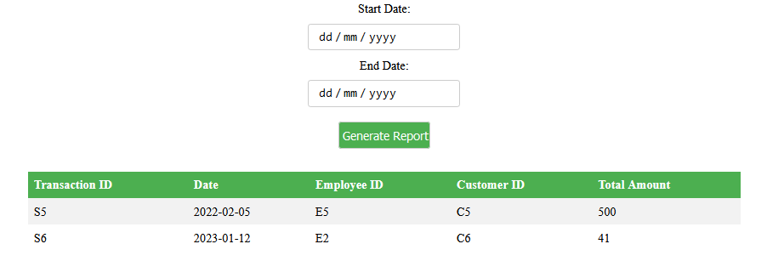
Administrator login i.e., security
Get between dates transactions report
This figure represents a screenshot of the "Get between dates transactions report" feature of the system.
It allows the user to generate a report of all transactions that occurred within a specified date range.
The screenshot shows the user interface for selecting the start and end dates for the report, along with options to filter and export the data.
The admin login page is a webpage that allows authorized users, typically administrators, to access the administrative features of a medical shop management project.
The page typically includes a form that users must fill out with their credentials, such as a username and password, in order to gain access to the administrative features.
The design of the admin login page is usually simple, with a minimalistic layout that focuses on the login form.

Slide 13
Conclusion
The Medical Management System is designed to automate the process of managing customer, employee, medicine, supplier, purchase, and sales data.
The system is implemented using MySQL and adheres to the principles of data normalization.
The system is user-friendly and easy to navigate, and it has the potential to improve the efficiency and productivity of the medical store.
The system includes features such as triggers, views, and stored procedures to enhance security and efficiency.
The Medical Management System is robust, reliable, and scalable to meet the evolving needs of the business.
The system is a valuable asset for the medical store, and it is expected to improve overall performance and competitiveness.

Slide 14
REFERENCES
[1] Fundamentals of Database Systems, Ramez Elmasri and Shamkant B. Navathe, 7th Edition, 2017, Pearson.
[2] Database management systems, Ramakrishnan, and Gehrke, 3rd Edition, 2014, McGraw Hill
[3] Silberschatz Korth and Sudharshan, Database System Concepts, 6th Edition, Mc-Graw Hill, 2013.
[4] Coronel, Morris, and Rob, Database Principles Fundamentals of Design, Implementation and Management, Cengage Learning 2012.
Website links:
[1] MySQL documentation in https://dev.mysql.com/doc/
[2] https://www.w3schools.com/mysql/default.asp
[3] https://www.w3schools.com/html/default.asp

